Slide 1
Battle of Neighborhood
How to Choose the Best Location in London to start an Indian Restaurant?

Slide 2
Introduction/Business Problem
Food and facility are significant to the success of a restaurant, but the location can be just as crucial, especially in the early years.
Not all locations are suitable for opening a restaurant.
The following points need to be considered before the business idea is put into action:
The style of the restaurant
The target customers
Competition
Menu
Location

Slide 3
Data
To solve the problem we need datasets based on:
The target audience: Age, Gender, Marital status, Employment status, Income
Existing Restaurants in each boroughs
Rateable Value Statistics for Commercial and Industrial Floorspace
Tourism spend estimates as well as domestic spend estimates

Slide 4
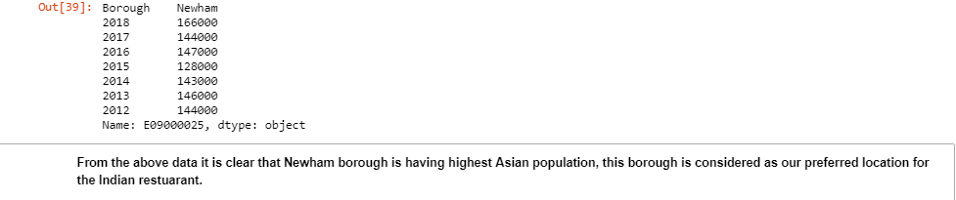
Methods and result
Import ethnic group: Find borough with highest population

Slide 5

Number of restaurants in Newham region

Slide 6
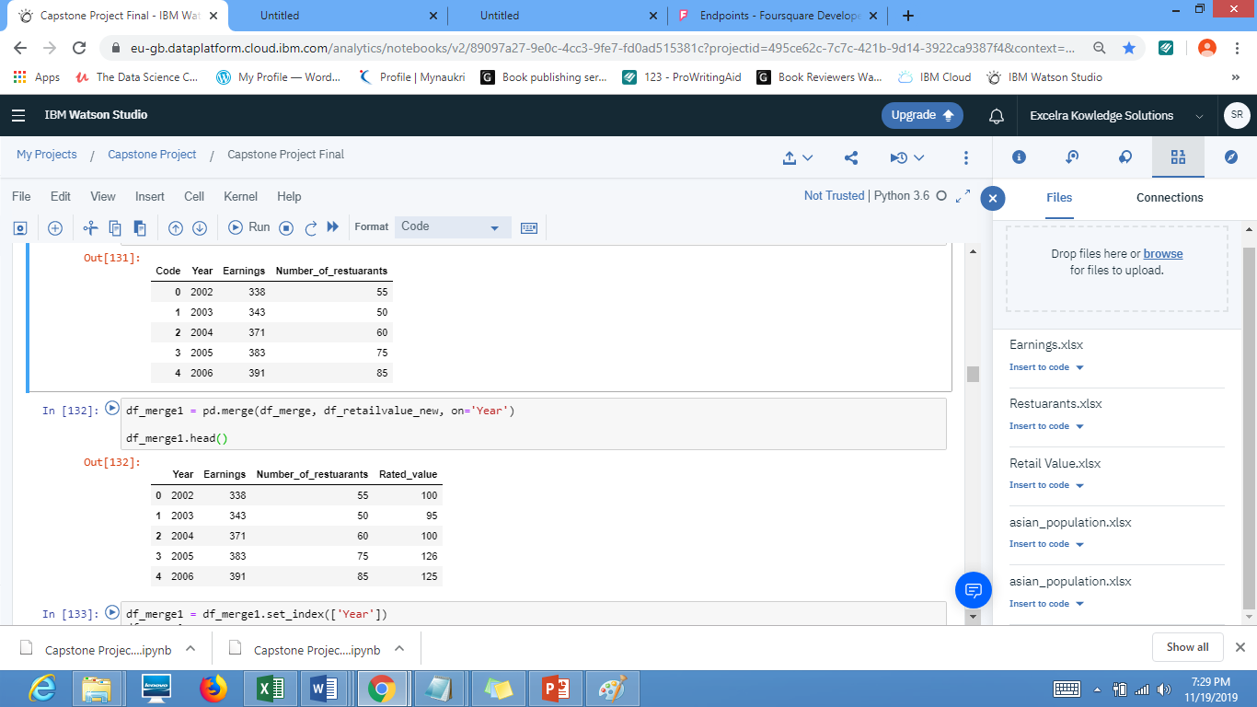
Merge 3 dataframes

Slide 7
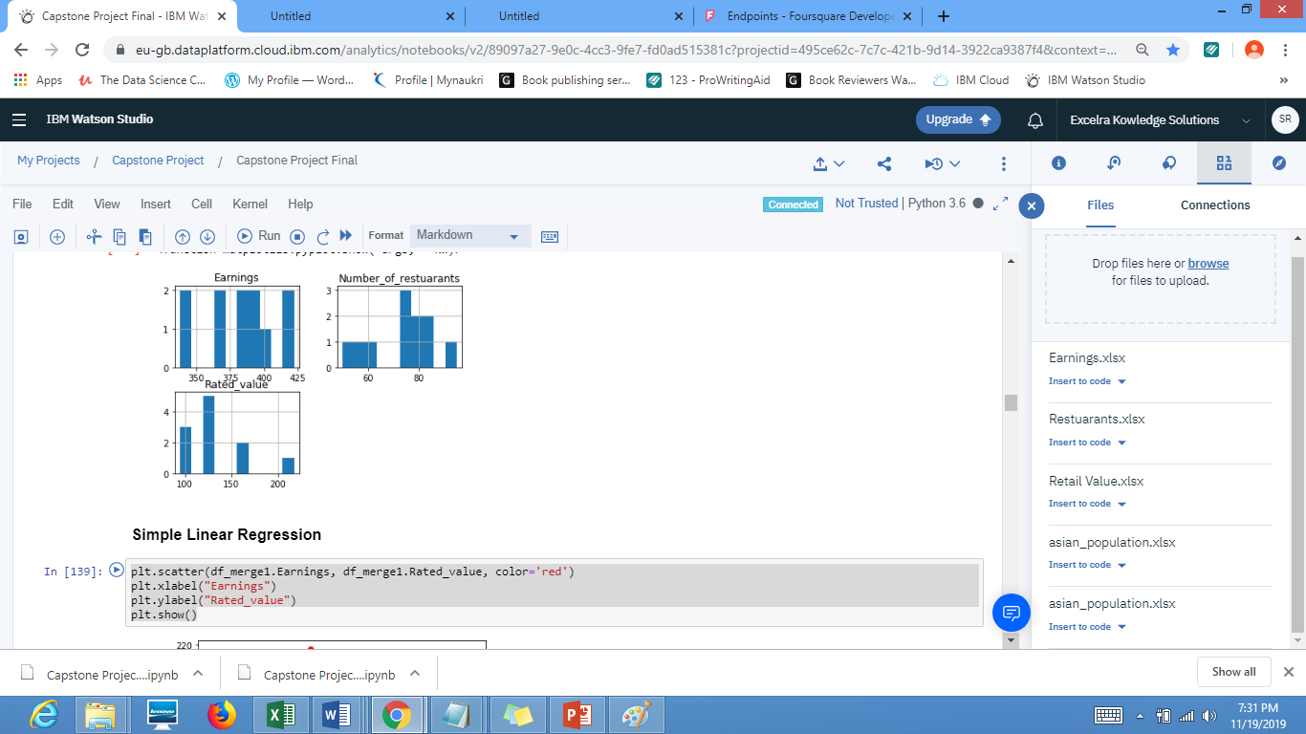
Exploratory data analysis

Slide 8
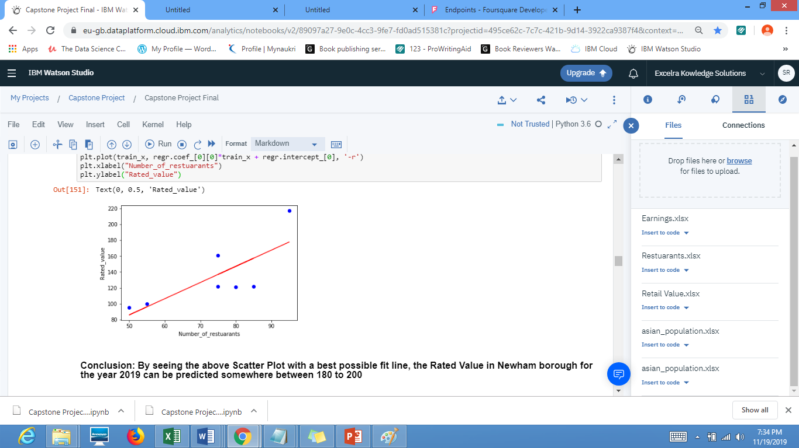
Train and Test Datasets

Slide 9
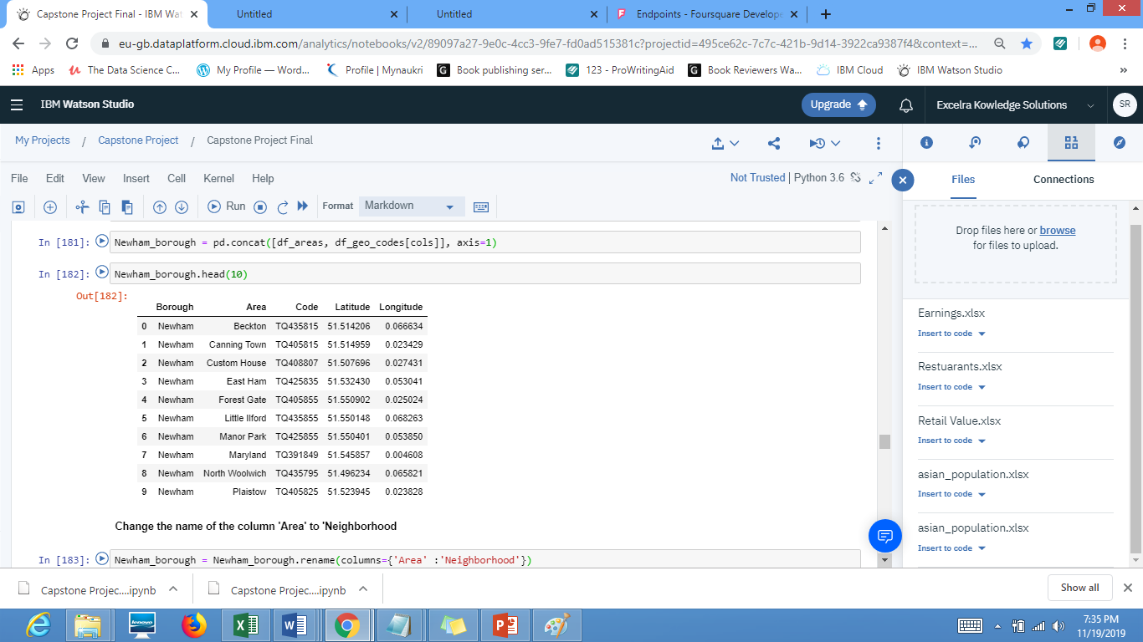
Exploring the datasets

Slide 10
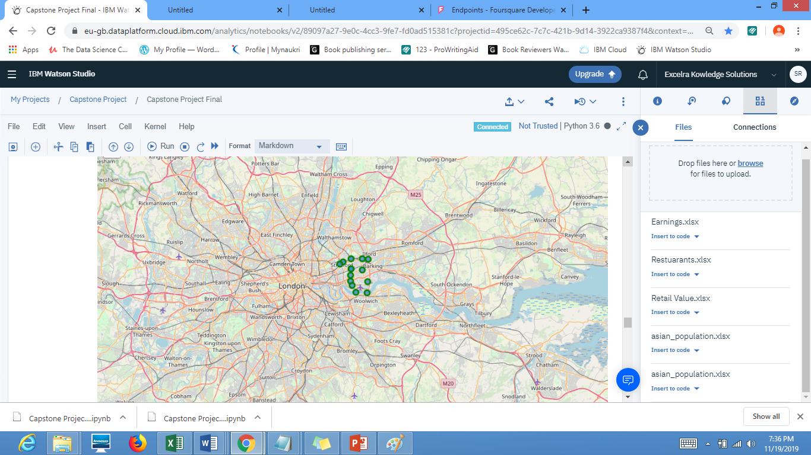
Visualize the Areas(Neighborhoods) of Newham Borough

Slide 11
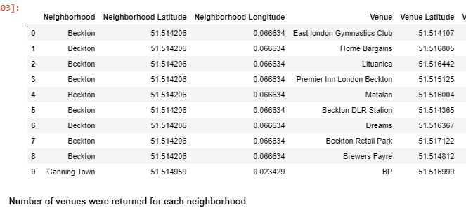
how many venues were returned by Foursquare? Ans: 9
Explore Neighborhoods in Newham Borough

Slide 12
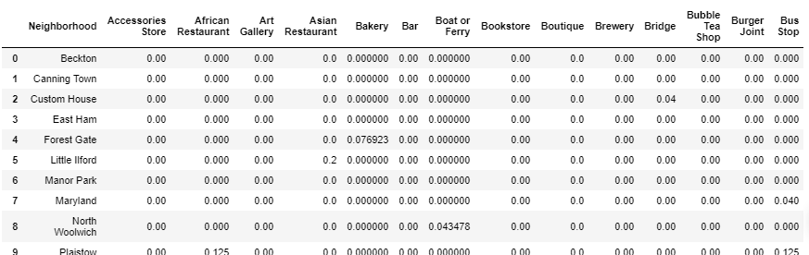
Number of unique categories: 94
Analyze Each Neighborhood in Newham borough

Slide 13
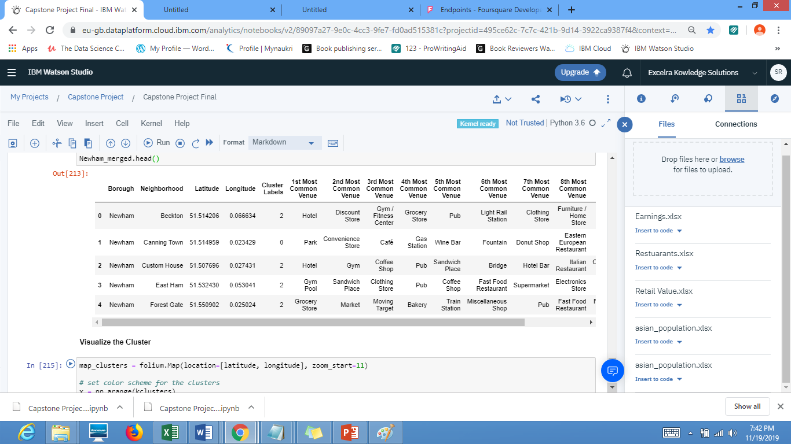
create a new dataframe that includes the cluster as well as the top 10 venues for each neighborhood

Slide 14
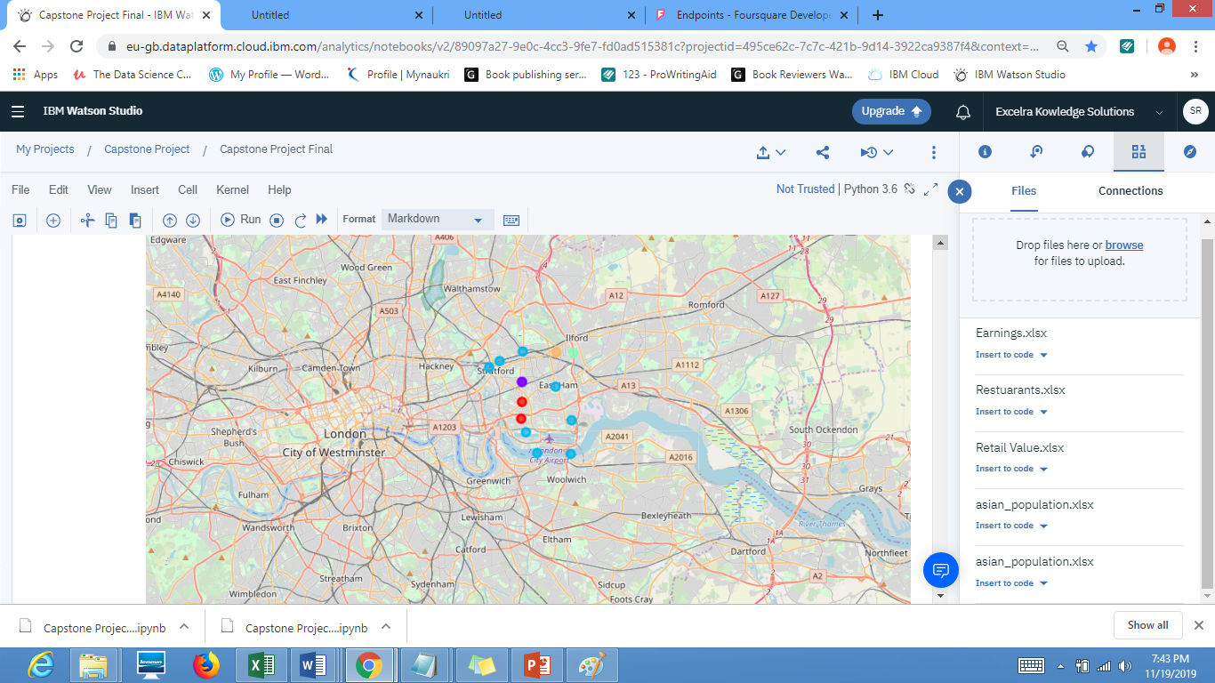
Visualize the cluster

Slide 15
Conclusion
According to the above data the best place to open an Indian restuarant (based on 1st most common venue data): Manor Park, Beckston, Maryland, Custom House and Plaistow. This area also high population of Asians including Indians. It wll be a good idea to start restuarant here.

